Slide 1
Kohonen Networks
By: Dr. Farhana desai

Slide 2
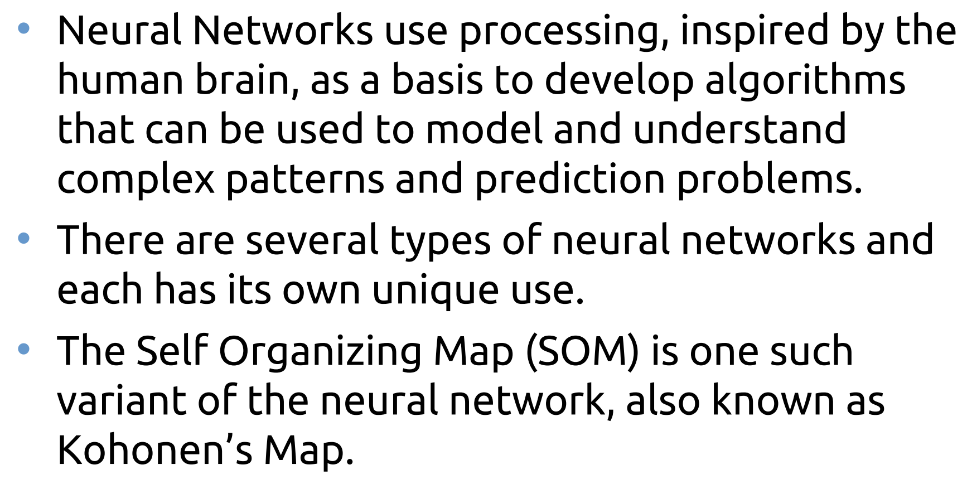
Pioneered in 1982 by Finnish professor and researcher Dr. Teuvo Kohonen,

Slide 3
K-means breaks the data into a predefined number of clusters (k) and assigns each data point to one of them. However, we must use the correct number of clusters for k-means to work. Finding the number can be tricky and require multiple guesses and runs, which takes time.
A better way would be to devise an algorithm that can guess the correct number of clusters on its own. This is where self-organizing maps come to the rescue.

Slide 4
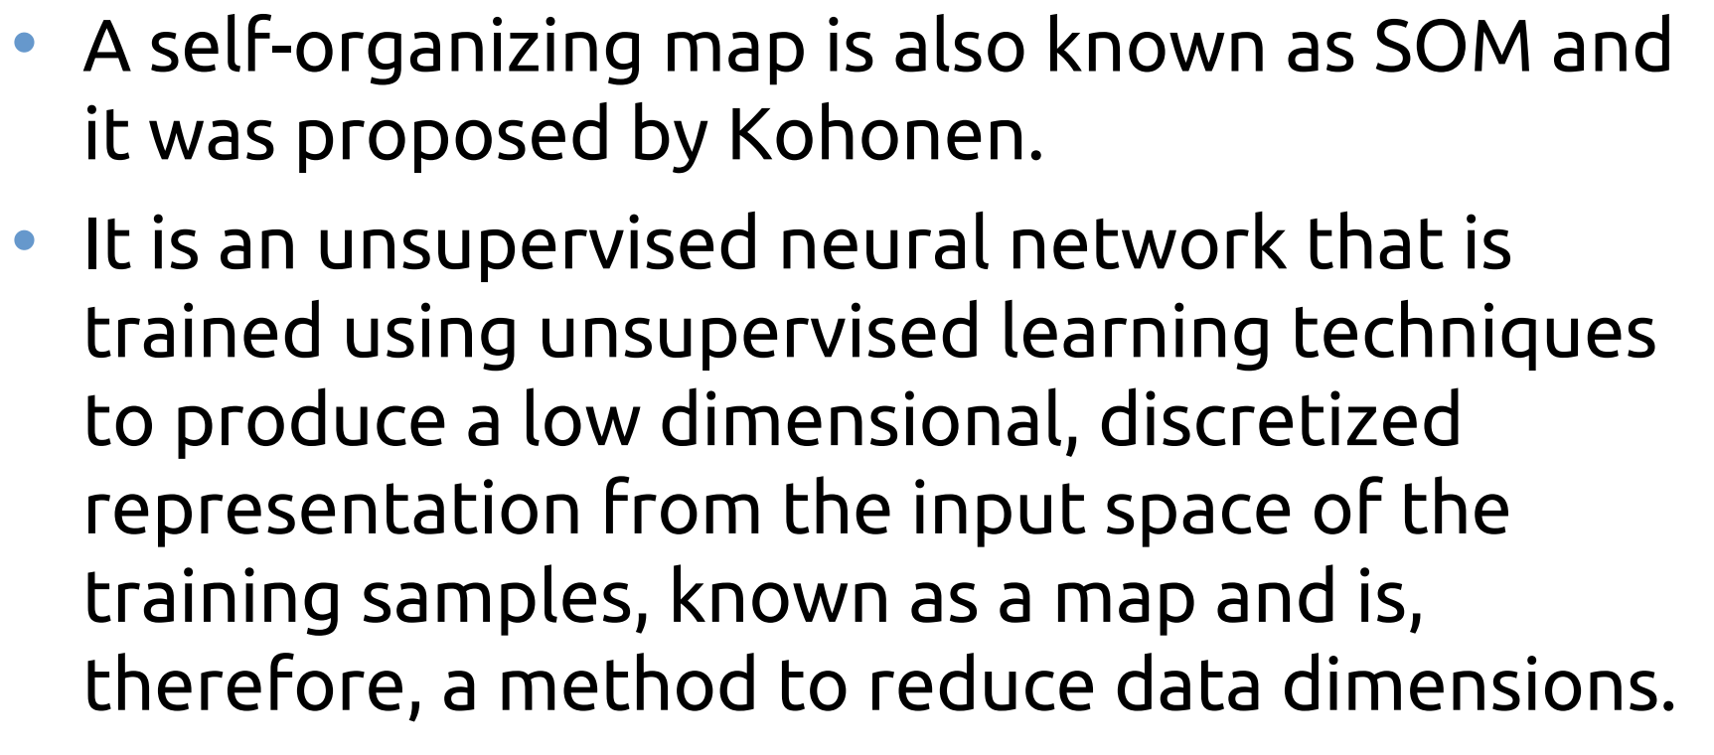

Slide 5
SOM is used for clustering and mapping (or dimensionality reduction) techniques to map multidimensional data onto lower-dimensional which allows people to reduce complex problems for easy interpretation.
SOMs accomplish two things, they reduce dimensions and display similarities.
SOM has two layers, one is the Input layer and the other one is the Output layer.

Slide 6
A SOM is a single-layer neural network. Its neurons are in a k * l lattice (we choose the values of k and l):

Slide 7
SOMs iteratively run three stages until convergence: competition, cooperation, and adaptation
In SOM, the competitive process is to search for the most similar neuron with the input pattern; the winner is called Best Matching Unit (BMU).
The BMU shares the privilege with its neighbours to learn together. The definition of the neighbourhood is determined by the network designer,
The effect of the learning is to move the weight of the winning and neighbouring neurons closer to the input pattern.

Slide 8
